Slide 1
Machine Learning Model Project
Student Performance and Customer Purchase Behavior
Tristan Grote
CSCI-164

Slide 2
Problem
Predict Student Success (pass/fail)
Predict customer purchase behavior
Compare model performance across datasets
Evaluate how model performance changes across datasets

Slide 3
Datasets
01
02
Student Performance
Study time, absences, demographic
More Structured
Target: pass/fail
Customer Purchase
Customer behavior features
More complex
Target: purchase decision
More Structured Dataset
More Complex Dataset

Slide 4
Preprocessing
Encoding categorical variables
Scaled numerical features
Handled missing data
Removed G1 and G2 (data leakage)
Prevents overfitting
Ensures fair model comparison

Slide 5
Models Used
Logistic Regression -> Linear model
K-Nearest Neighbors (KNN) -> distance-based
Multi-Layer Perceptron (MLP) -> non-linear

Slide 6
Training and Tuning
80/20 train-test split
GridSearchCV for tuning
Evaluated using accuracy, F1, ROC-AUC
Cross-validation improves reliability
Tuning optimizes model performance

Slide 7
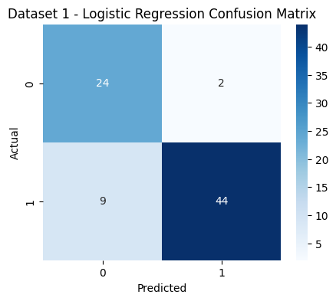
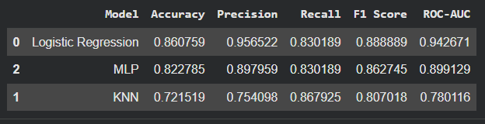
Student Performance Results
Logistic Regression: 86.1% (best)
MLP: 82.3%
KNN: 72.2%
ROC-AUC highest: 0.94
Data shows strong linear relationships
KNN performs worse due to sensitivity to feature scaling and noise

Slide 8
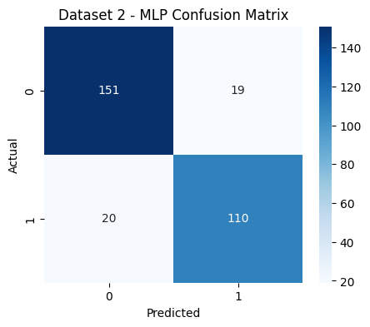
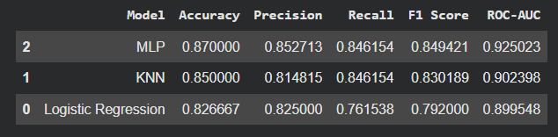
Customer Purchase Results
MLP: 87.0% (best)
KNN: 85.0%
Logistic Regression: 82.7%
ROC-AUC highest: 0.93
MLP captures complex, non-linear patterns
KNN performs well due to flexible decision boundaries

Slide 9
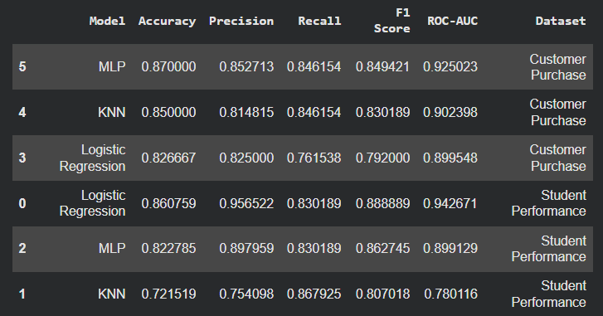
Model Comparison
Key Comparisons
Student Dataset -> Logistic Regression
Customer Dataset -> MLP
KNN performance varies across datasets
Key Insight
Model performance depends on dataset complexity
Simpler models work well on structured data
Complex models perform better on non-linear data

Slide 10
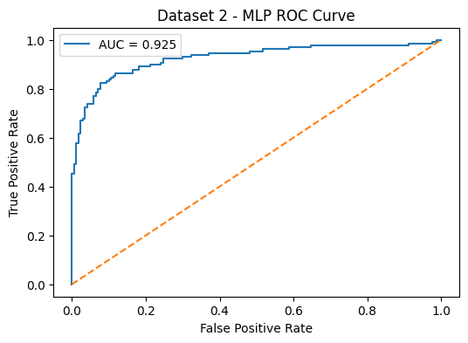
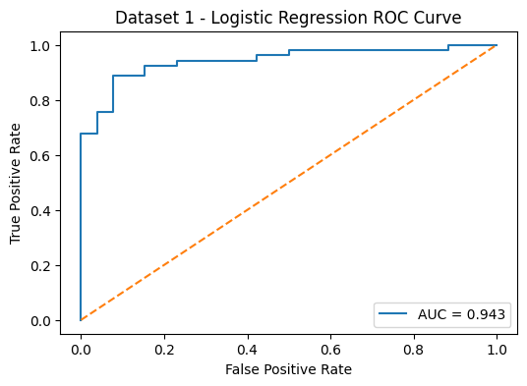
ROC Curve Insights
Logistic Regression -> best for Student dataset (AUC ≈ 0.94)
MLP -> best for Customer dataset (AUC ≈ 0.93)
High AUC values indicate strong class separation
Results confirm model comparison findings

Slide 11
Key Takeaways
Model performance depends on dataset characteristics
Logistic Regression performs well on structured, linear data
MLP performs better on complex, non-linear data
KNN performance varies depending on the dataset
Hyperparameter tuning can improve performance but not guarantee

Slide 12
Conclusion
Compared 3 models across 2 datasets
Logistic Regression performed best for Student Dataset
MLP performed best for Customer dataset
Model performance depends on the dataset
No single model is best for all problems

